Slide 1

CarWatcher – Contiki-ng application

Slide 2

About Contiki-NG
In 2017, Contiki-NG started as a fork of the Contiki operating system with the following goals:
Focus on dependable (reliable and secure), standard-based IPv6 communication
Focus on modern IoT platforms, e.g. ARM Cortex M3 and other 32-bit MCUs
Modernize the structure, configuration, logging and platforms, to reflect the goals above;
Improve the documentation, both code API, module description, and tutorials;
Implement a more agile development process, with easier inclusion of new features, and with periodic releases.

Slide 3
About Contiki-NG
Contiki-NG is an operating system for resource-constrained devices in the Internet of Things.
Contiki-NG contains an RFC-compliant, low-power IPv6 communication stack, enabling Internet connectivity.
The system runs on a variety of platforms based on energy-efficient architectures such as the ARM Cortex-M3/M4 and the Texas Instruments MSP430.
The code footprint is on the order of a 100 kB, and the memory usage can be configured to be as low as 10 kB.

Slide 4
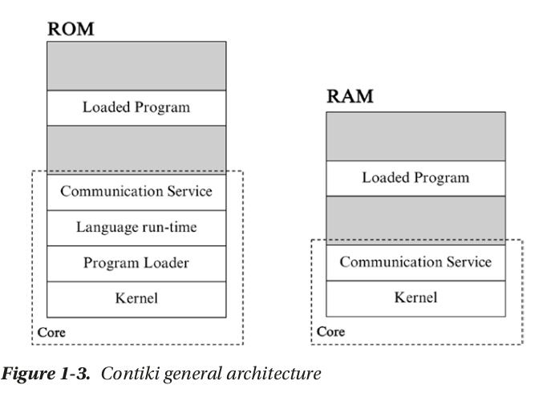
Contiki OS architecture
Kernel, the program loader, the language run-time, and the communication service are static modules within the ROM of Contiki OS.
All user programs will be loaded into Loaded Program. Only the kernel
and the communication service will be used by the Contiki OS RAM.

Slide 5
Process Definition
The PROCESS() macro takes two arguments: one is the variable with which we identify the process, and the other is the name of the process
#include "contiki.h" /* Main include file for OS-specific modules. */
#include <stdio.h> /* For printf. */
PROCESS(test_proc, "Test process");
AUTOSTART_PROCESSES(&test_proc);
A basic process can then be implemented as follows:
PROCESS_THREAD(test_proc, ev, data)
{
PROCESS_BEGIN();
printf("Hello, world!\n");
PROCESS_END();
}

Slide 6
Stopping processes
A process can be stopped in three ways:
The process implicitly exits by allowing the PROCESS_END() statement to be reached and executed.
The process explicitly exits by calling PROCESS_EXIT() in the PROCESS_THREAD body.
Another process kills the process by calling process_exit().
After stopping a process, it can be restarted from the beginning by calling process_start().

Slide 7
Events and Scheduling
Contiki-NG is built on an event-based execution model, where processes typically perform chunks of work before telling the scheduler that they are waiting for an event, and thereby suspend execution. Such events can be the expiration of a timer, an incoming network packet, or a serial line message being delivered.
Processes are scheduled cooperatively, which means that each process is responsible for voluntarily yielding control back to the operating system without executing for too long. Hence, the application developer must make sure that long-running operations are split into multiple process schedulings, allowing such operations to resume at the point where they last stopped.

Slide 8
Events and Scheduling
By calling PROCESS_WAIT_EVENT_UNTIL() in the area separated by the PROCESS_BEGIN() and PROCESS_END() calls, one can yield control to the scheduler, and only resume execution when an event is delivered.
PROCESS_THREAD(test, ev, data)
{
/* An event-timer variable. Note that this variable must be static
in order to preserve the value across yielding. */
static struct etimer et;
PROCESS_BEGIN();
etimer_set(&et, CLOCK_SECOND); /* Trigger a timer after 1 second. */
while(1) {
PROCESS_WAIT_EVENT_UNTIL(etimer_expired(&et));
etimer_reset(&et);
}
PROCESS_END();
}

Slide 9
Timers
Contiki-NG provides a set of timer libraries that are used both by applications and by the OS itself. The timer libraries contain functionality for checking if a time period has passed, waking up the system from low power mode at scheduled times, and real-time tasks scheduling.
All the timers build on the clock module, in charge of basic system time:
timer: a simple timer, without built-in notification (caller must check if expired). Safe from interrupt.
stimer: same as timer, but in seconds and with significantly longer wrapping period. Safe from interrupt.
etimer: schedules events to Contiki-NG processes. Unsafe from interrupt.
ctimer: schedules calls to a callback function. Unsafe from interrupt.
rtimer: real-time task scheduling, with execution from ISR. Safe from interrupt.

Slide 10
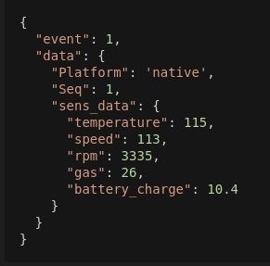
CarWatcher
Car-Watcher is application that takes care of all your vehicles that you rent/lend to other people.
Contiki-ng Car-Watcher client application is collecting vehicle data and sending it to car_watcher platform where it is processed and saved. Example of data sent:

Slide 11
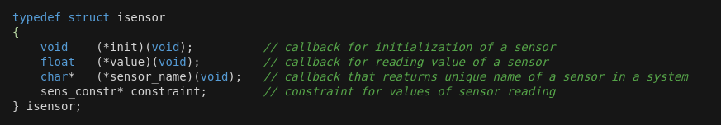
CarWatcher - isensor struct
All defined sensors are located in sensors folder. sensor.h file contains interface definition that every sensor should implement in order to be used in Car-Watcher app
Also sensor.h contains definition for some basic operations to work with defined sensors.

Slide 12

CarWatcher - received message form
Contiki Car-Watcher can communicate with some server using some broker that supports MQTT protocol (in this example rabbitmq). Messages sent to Contiki client should have the following form:
Every message needs to have message number field set that determines what Contiki client should do. List of all currently supported message numbers is defined in car-watcher.h file which include start/stop sending readings data, sending a warning to driver, changing reading interval.
For receiving messages, it registers a mqtt_event callback function that is used for handling mqtt messages.
mqtt_register(&conn, &mqtt_client_process, client_id, mqtt_event, MAX_TCP_SEGMENT_SIZE);

Slide 13
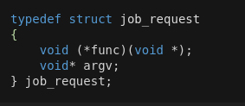
CarWatcher - job_request struct
After receiving a message, Car-Watcher processes and confirms that message was received. In case of more demanding processing a job_request is created and message is confirmed.
All created job_requests are stored in job_list. Main process executes this list after every event (it is possible to define etimer that will trigger events for this processing).
Upon startup, Contiki client initializes sensors, mqtt configuration and job list, connects to broker, defines callback for received messages and starts sending data.

Slide 14
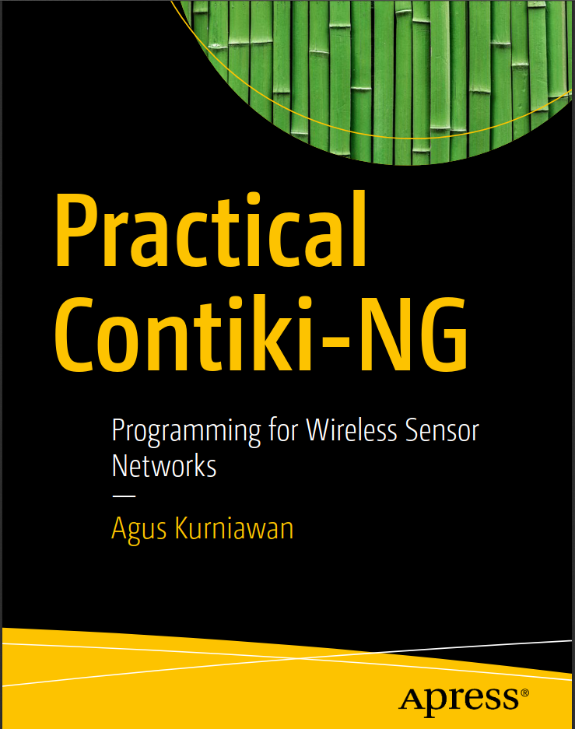

References
Official Contiki-NG github page
Books:
Practical Contiki-NG
Internet of Things in 5 days

